Slide 1
Python Unit Testing

Slide 2
Agenda
Warm-up
Theory Section
Exercise 1:
Exercise 2:
Exercise 3: Stretch Exercise
Recap

Slide 3
https://github.com/Gromm21xx/Unit_Testing
Learning Objectives
Understand the importance of unit testing and its place in the testing pyramid
Write and run effective unit tests using pytest, including happy paths, unhappy paths, and edge cases
Implement the Arrange-Act-Assert (AAA) pattern in unit tests
Apply Test-Driven Development (TDD) principles using the Red-Green-Refactor cycle
Implement advanced testing techniques such as mocking and patching
Write testable code and refactor existing code to improve test coverage and maintainability

Slide 4
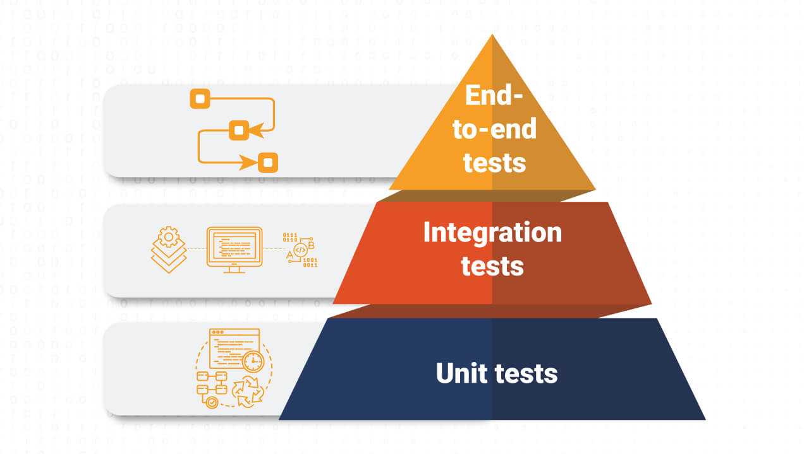
Importance of unit testing and the testing pyramid
Catches bugs early in the development process
Improves code quality and maintainability
Serves as documentation for code behavior
Facilitates safe refactoring and code changes
Enhances developer confidence and productivity

Slide 5
Principles of Test-Driven Development (TDD)
Write tests before writing code
Follow the Red-Green-Refactor cycle
Leads to more focused and modular code design
Provides instant feedback on code functionality
Results in a comprehensive test suite

Slide 6
Arrange-Act-Assert (AAA) pattern
Arrange: Set up the test conditions
Act: Execute the code being tested
Assert: Verify the results
- Improves test readability and structure
- Helps isolate what's being tested

Slide 7
Happy paths, unhappy paths, and edge cases
Happy path: Expected, normal flow of operation
Unhappy path: Error conditions and unexpected inputs
Edge cases: Extreme or unusual scenarios
Comprehensive testing includes all three types
Helps ensure robust and reliable software

Slide 8
Introduction to Mocking and Patching
Mocking: Creating fake objects to simulate behaviour
Patching: Temporarily replacing a function or object during testing
Use cases: Testing external dependencies, APIs, or complex objects
Benefits: Isolation, control over test scenarios, faster test execution

Slide 9
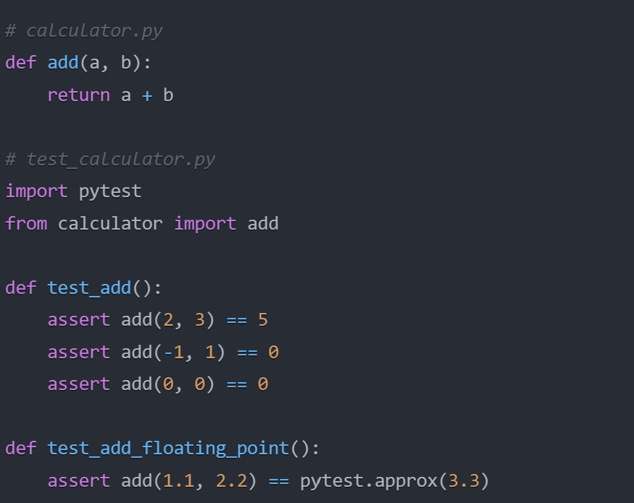
Introduction to pytest
Popular Python testing framework with simple syntax
Write tests as functions starting with'test_’
Use 'assert' statements to check conditions
Example: assert add(2, 3) == 5
Run tests with 'pytest' command in terminal
Powerful features: fixtures, parameterized testing
Extensive plugin ecosystem for added functionality

Slide 10
Running Tests from the Command Line
Run all tests in current directory: pytest
Run tests in a specific file: pytest test_file.py
Run a specific test function: pytest test_file.py::test_function_name
Run tests matching a pattern: pytest -k "pattern"
Run tests with detailed output: pytest -v
Show extra test summary info: pytest -ra

Slide 11
Practical Exercise 1: Writing Unit Tests using the unittest Class
Instructions for ‘Practical Exercise 1.md’ : https://github.com/Gromm21xx/Unit_Testing

Slide 12
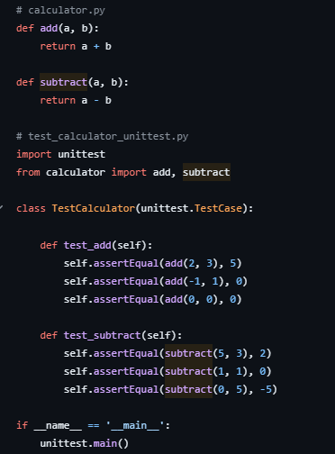
Practical Exercise 1 - Discussion

Slide 13
Practical Exercise 2: Unit Testing with pytest
Instructions for ‘Practical Exercise 2.md’ : https://github.com/Gromm21xx/Unit_Testing

Slide 14
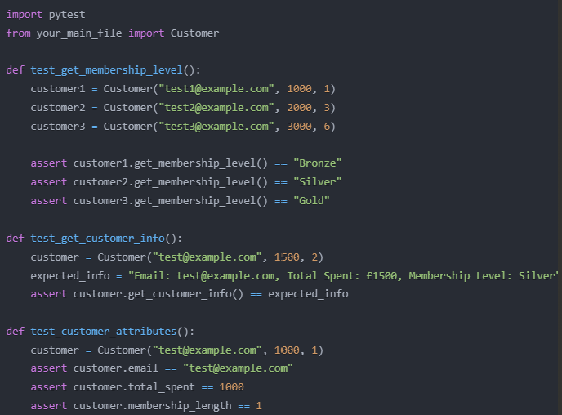
Practical Exercise 2 - Discussion

Slide 15
Stretch Activities
TDD Exercise Stretch Exercise https://github.com/Gromm21xx/Unit_Testing

Slide 16
Recap of learning outcomes
Understand the importance of unit testing and its place in the testing pyramid
Write and run effective unit tests using pytest
Implement the Arrange-Act-Assert (AAA) pattern in unit tests
Apply Test-Driven Development (TDD) principles using the Red-Green-Refactor cycle
Implement advanced testing techniques such as mocking and patching
Write testable code and refactor existing code to improve test coverage and maintainability

Slide 17
CHEAT SHEET
AAA
AAA pattern: Arrange, Act, Assert
TDD
Test-Driven Development: Red: Write a failing test, Green: Write minimal code to pass the test
pytest
Name test files with "test_" prefix • Name test functions with "test_" prefix • Run tests: pytest test_file.py • Run specific test: pytest test_file.py::test_function
Mocking
Use mock objects to simulate behavior
Patching
Patch to temporarily replace functions/objects
Best Practice
Keep tests independent and isolated • Test happy paths, edge cases, and error conditions • Aim for high test coverage (>85% at JLR) • Regularly run and maintain tests

Slide 18
Thank you

